Slide 1
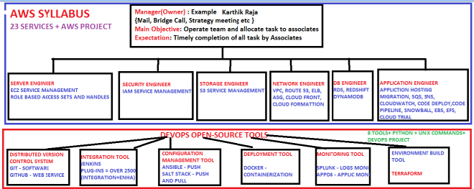

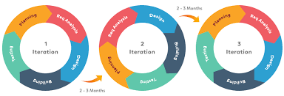

AWS AND DEVOPS SYLLABUS
Disadvantages:
Conflicts between dev and delivery
Configuration Mismatches
No continuous Deployment

Slide 2
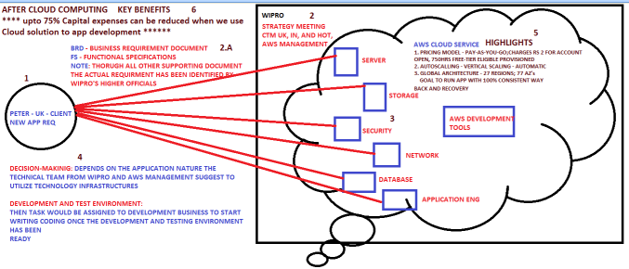
AWS

Slide 3
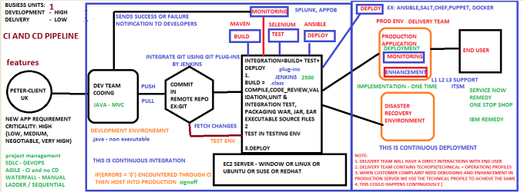
DEVOPS

Slide 4
SDLC PHASES
REQUIRMENT GATHERING
PLANNING
DESIGN
CODING
IMPLEMENTATION
TESTING
DEPLOYMENT
MAINTAINENCE

Slide 5
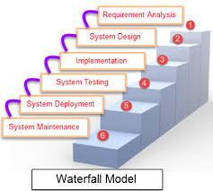
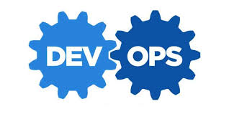

SDLC MODELS
Disadvantages:
Linear sequential
Client requirement may changes
Difficult to handle complex queries
Disadvantages:
Conflicts between dev and delivery
Configuration Mismatches
No continuous Deployment
Automation and tools + AGILE
Set the Roadmap to software delivery
Preferred Skill: Communication, Collaboration and Philosophies
Usage: Enables Organiation ability to deliver the high end project
Objective /Goal: Eliminate wastages from Project via CSI [ITIL]

Slide 6
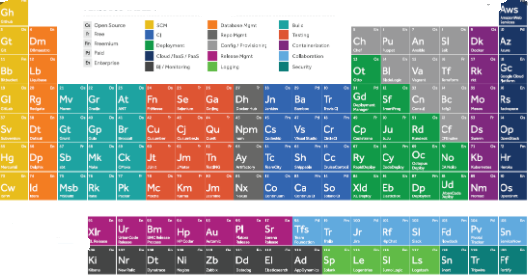
DEVOPS – PERIODIC TABLE

Slide 7
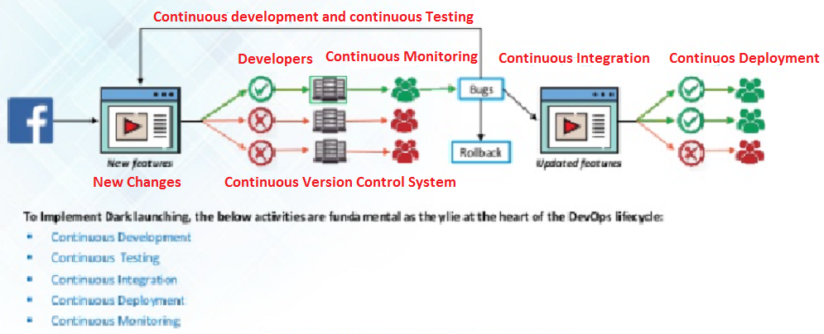
USE CASE: DARK LAUNCHINIG
SINGLE USER BASE and CI CD : Facebook introduced on 2005.
In 2009 kick started and completed in 2011, Facebook decided to undergo huge change
Single user base Technique
Everything done on a continuous fashion and moved the build to production once all issues recovered.

Slide 8
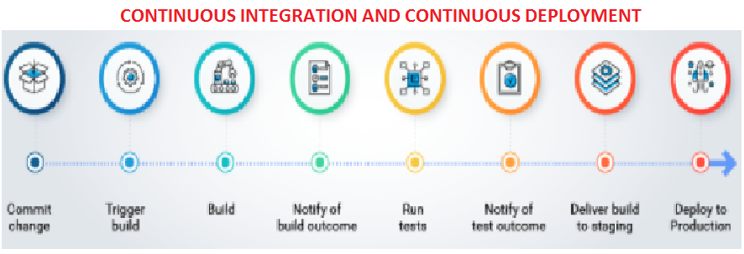
CI CD PIPELINE
CI CD PIPELINE STAGES:
COMMIT – Record the changes made and commit
BUILD (Compilation, Code_review, Validation, Unit Test, Integration Test, Packaging)
TEST– Test report notification to the user
MONITORING : Notify bug report to developers
UAT DEPLOYMENT: Implementation on Testing Environment
PRODUCTION DEPLOYMENT: Implementation on Production Environment

Slide 9
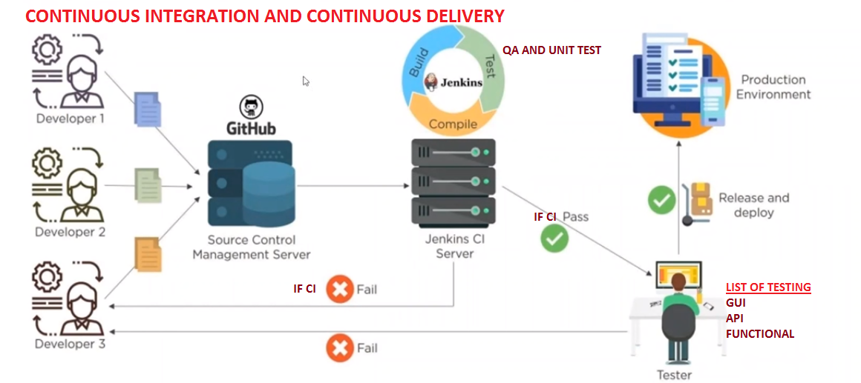
DEVOPS – CI AND CD PIPELINE

Slide 10
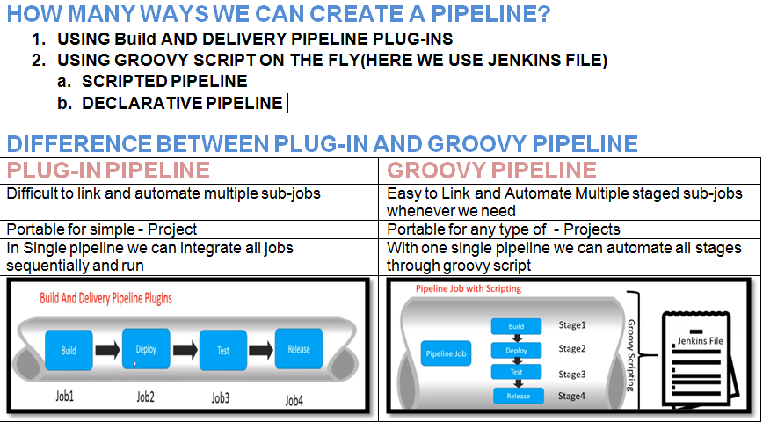
DEVOPS – CI AND CD PIPELINE

Slide 11
DEVOPS – CONTINUOUS INTEGRATION
JENKINS
JENKINS SET-UP

